Slide 1
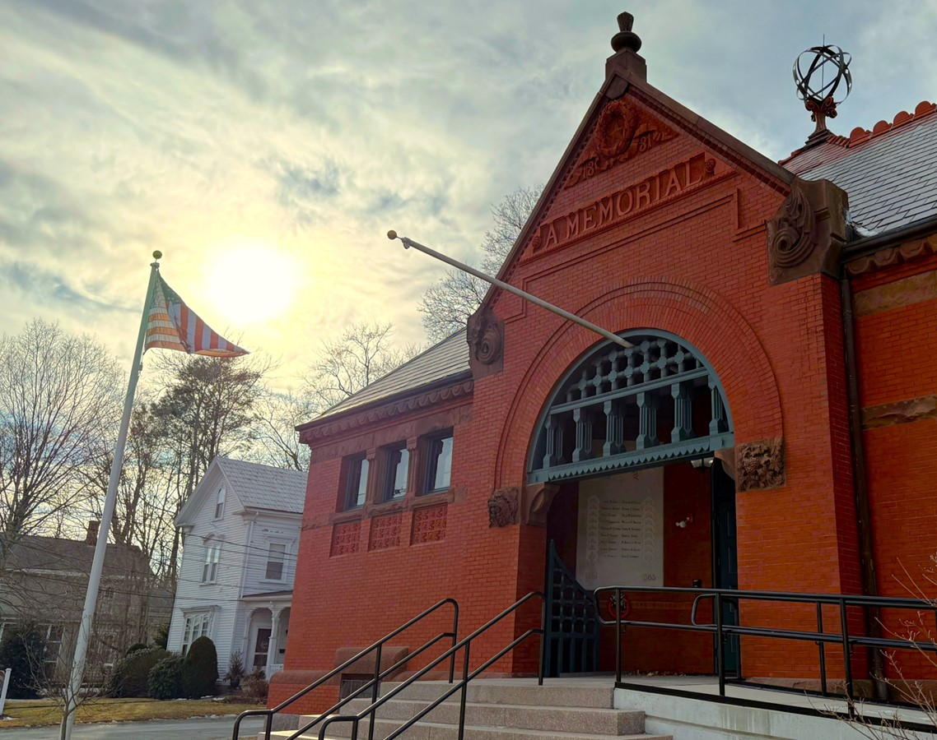
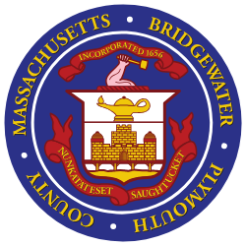
Public Works
Water
Supply System
Update
October 21, 2025

Slide 2
Department of Public Works Overview
Bridgewater Department of Public Works manages the Town’s public infrastructure, including water supply, treatment, and distribution; wastewater collection, treatment, and discharge; roadways and transportation. With the foregoing, the DPW holds paramount the safety, health, and welfare of this community.
In this presentation, we will provide an overview of our water supply system-related projects. Whereas this presentation discusses major capital projects, it should be noted that there are several maintenance projects on our existing active wells and the distribution system that aim to provide stable and safe water to the Town’s residents.

Slide 3

The DPW welcomes the NEW!
Water Superintendent
William (Bill) Young
who is here with us this evening

Slide 4
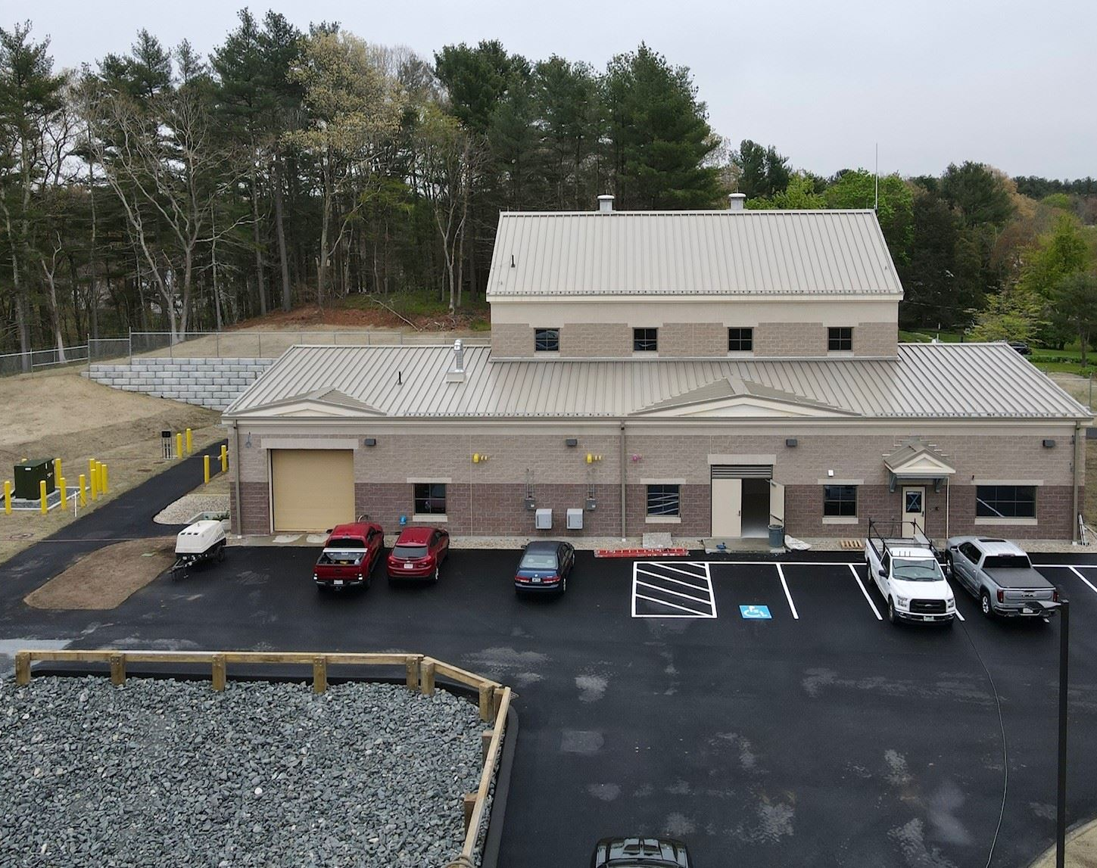
Water
Supply System
Update
Department of Public Works
High Street Water Treatment Plant

Slide 5
Water Capacity Update
The Town currently has a permit of 1.98 million gallons per day (MGD).
Currently, the Town averages 1.55 MGD withdrawal from our wells.
The Town has activated well 10B because water levels in our storage tanks were low (critical for fire suppression), and we are undergoing well cleaning and redevelopment to increase the capacity and production of our current wells.
These efforts increase our capacity to meet the water demands of our users.
Projects that would affect the Town’s water capacity are:
  Wells 10A & 10B being tied to the High Street plant – 2-year timeline
  Vernon St. Wells – No timeline established until all the options are evaluated.
  Aquaria Desalination Plant – No projected timeline until further discussions with Brockton.

Slide 6
Water Quality Update
The Town is not currently under a “Do Not Drink” order (Mass Department of Environmental Protection).
We understand the concerns regarding discolored water and PFAS removal projects. Activation of Well 10B leads to discoloration and elevated manganese levels.
Projects that would affect the Town’s water quality are:
  Wells 10A & 10B being tied to the High Street plant – 2-year timeline
  Carver Pond PFAS Removal – 2029 per EPA
  High Street PFAS Removal– 2029 per EPA

Slide 7
Water System Priorities
Maximize withdrawals from wells to meet water demand
Meet all regulatory requirements
Maintain well storage capacity for emergencies
Plan for additional water sources
Ensure financial stability of the water enterprise fund

Slide 8
Ongoing Capital Projects
Notes:
1. Flagg St. Water Main replacement 2,006 ft. estimate $1,003,000 2017 dollars. ENR 2017 11062 ENR 2024 13556 (1.23 multiplier) correlates to $615 per hour
2. Cross St Water Main replacement 6,962 ft estimate $3,481,000 2017 dollars

Slide 9
Replacement Wells 9R & 5R
Project Priority
High
Actual Cost
$1.8 million
Revenue Source
Bond Issue
Completed
Status
Needed to increase well production to meet demand for water

Slide 10
Plymouth St Wells (10A & 10B) – Transmission Line & Pump Upgrades to High Street Treatment Plant
Project Priority
High
Estimated Cost
$7.1 million
Revenue Source
Town funds – survey & engineering $478,000
Put the project out to bid ASAP
Status
Removes iron and manganese from the raw water (brown water complaints)
Wells are not fully utilized to meet demand due to this issue
DWSRF Low Interest Loan $6.6 million
Complete survey and design
Obtain DEP approval for the project

Slide 11
Planned Capital Projects FY26-30

Slide 12
Funding Options
Water Retained Earnings
Low Interest Loans
State and Federal Grants
Class Action Lawsuits
Water System User Fees

Slide 13
Final Comments/Questions
The Town realizes there are concerns about our water infrastructure and capacity. The team is focused on:
  Ensuring that we are meeting federal and state requirements to deliver the water quality that our residents and users deserve.
  Ensuring that we are being judicious about projects that tie into our water system.
  Undergoing further study to evaluate our interconnection system costs and opportunities to add further revenue to our water enterprise fund and mitigate increased costs on existing users.
  Working expeditiously with our consultant and contractors to meet or exceed our estimated timelines on completion of projects.
  Applying for and utilizing opportunities available for us to receive monetary support outside of the current base of users (re: grants, low-interest loans, PFAS lawsuit settlement funds).
  Evaluating all opportunities that will lead to an increase in our withdrawal permit and an increase in our water capacity.

